Slide 1
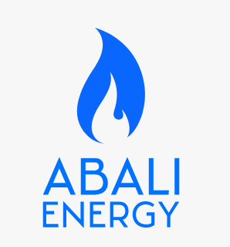
Agenda
Introduction to Abali Energy
About Abali Energy
Our Services
Explore Our Products
Our Unique Value Proposition
Conclusion
Providing Sustainable Solutions to Your Oil and Gas Business

Slide 2
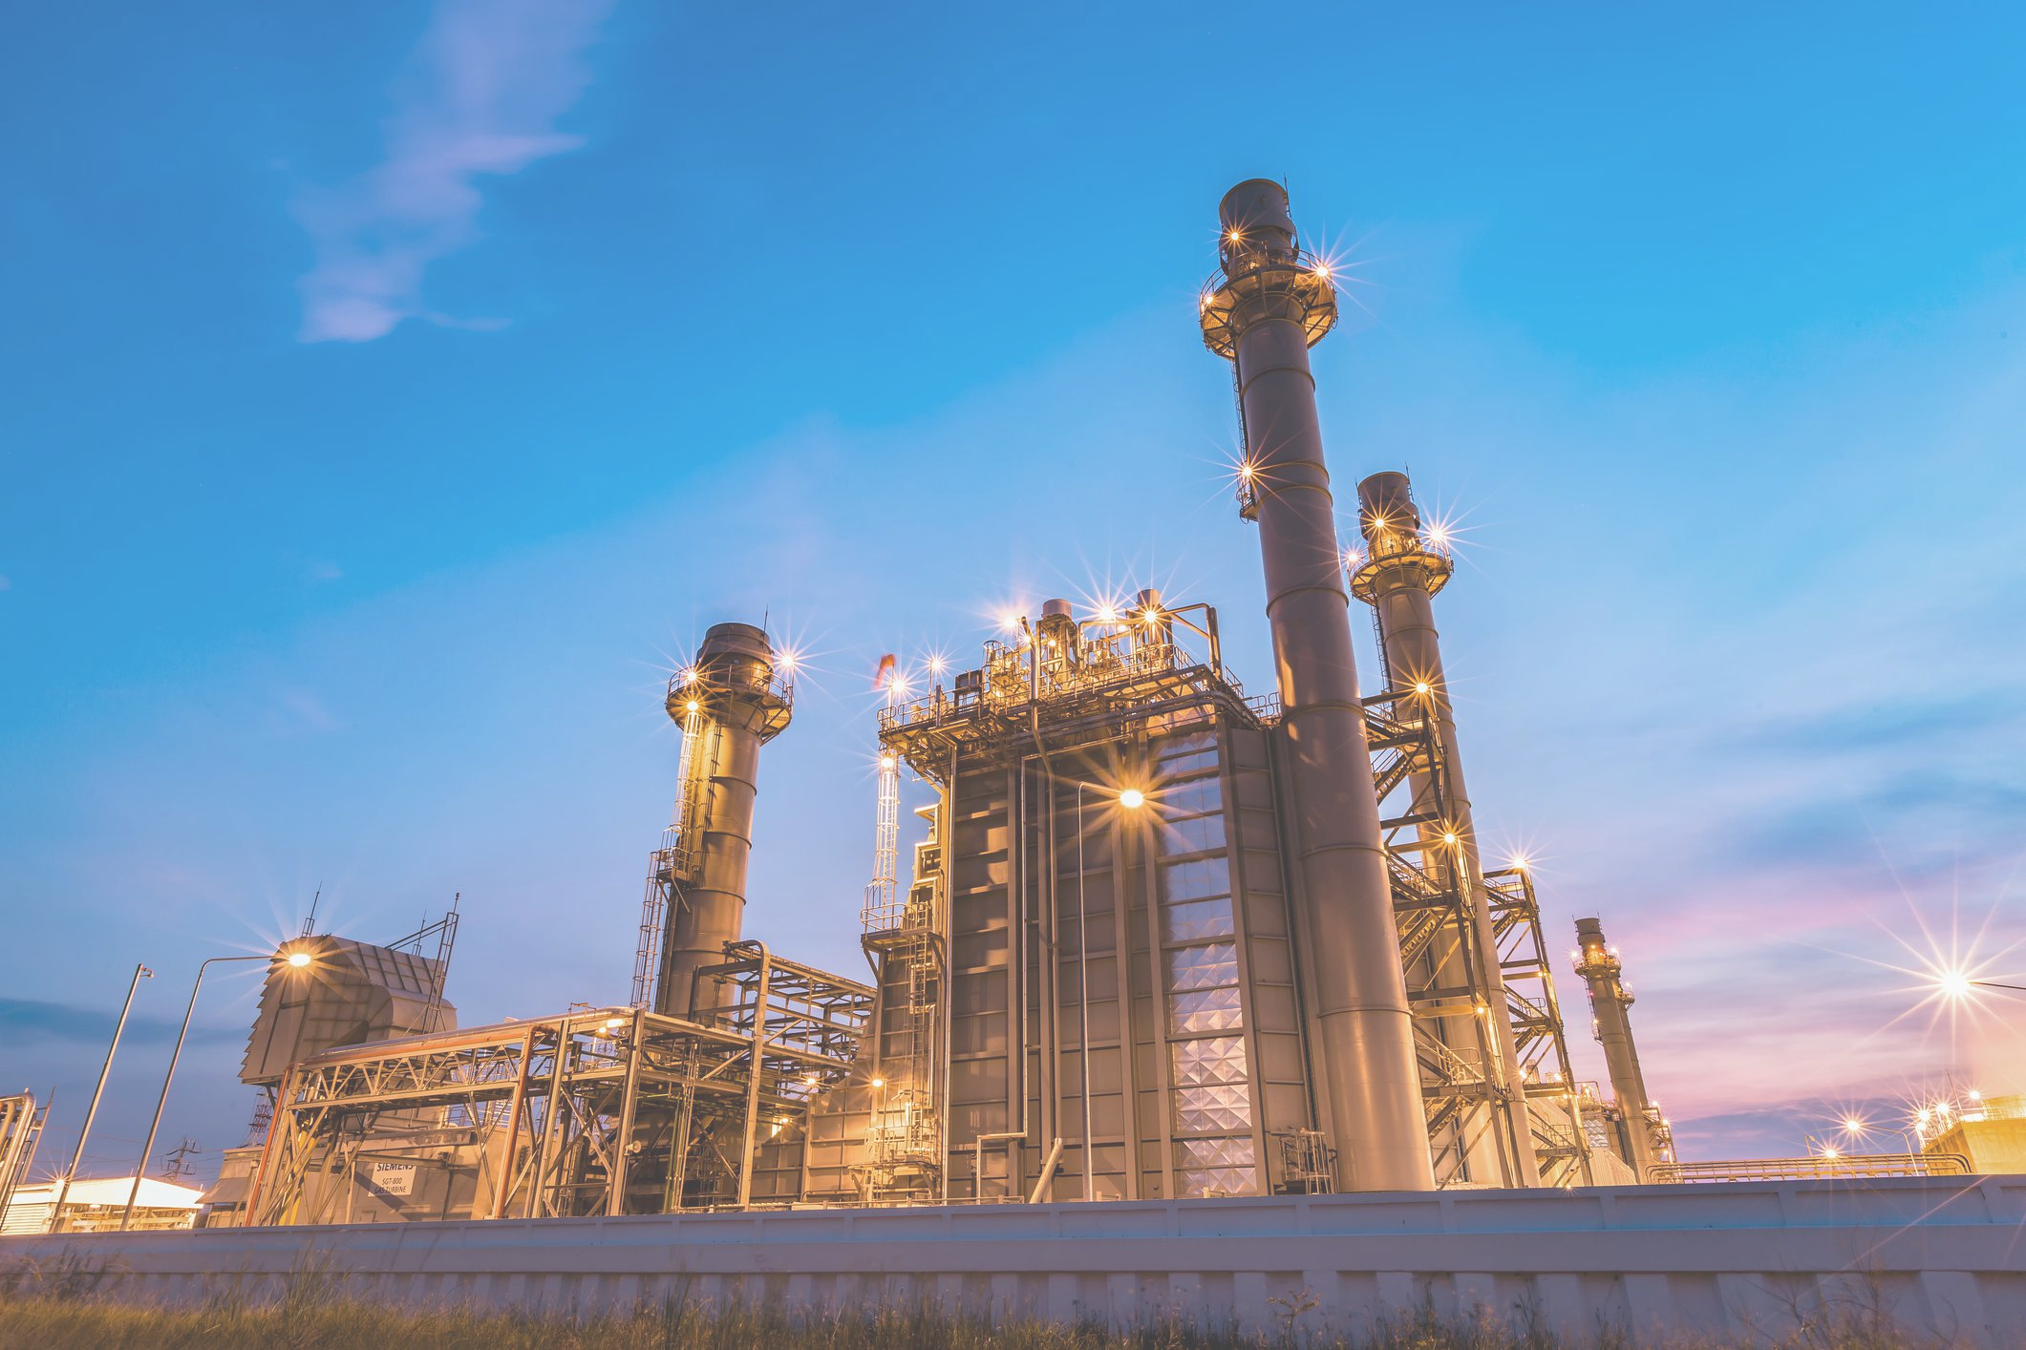
Introduction to Abali Energy
Overview
Abali Energy Overview
Abali Energy is a native and unified oil and gas corporation dedicated to delivering sustainable energy solutions.
The company focuses on providing clean and efficient energy to communities, enhancing their quality of life.
Abali Energy’s mission is to collaborate with stakeholders in distributing natural gas and petroleum products sustainably.
The vision emphasizes empowering communities with affordable energy while pursuing innovative green energy alternatives.

Slide 3
About Abali Energy
Overview
Our Mission
Abali Energy aims to distribute natural gas and petroleum products in an environmentally friendly manner, supporting communities through logistics and consulting.
Our Vision
We strive to empower communities with affordable, clean, and efficient energy solutions while researching innovative green energy alternatives to enhance quality of life.
Our Values
Community and environmental health are our top priorities. We emphasize teamwork, transparency, and a commitment to serving the needs of the local population.

Slide 4
Our Services
Services
Abali Energy provides oil and gas consulting services throughout Africa, helping clients navigate the complexities of the industry and make informed decisions.
The company acts as a broker in the oil and gas sector, facilitating transactions and ensuring that clients achieve the best possible outcomes.
Abali Energy specializes in the import and export of crude oil, leveraging its extensive network to source and distribute high-quality products efficiently.
The commitment to sustainability is reflected in all services, with a focus on environmentally friendly practices and community empowerment.

Slide 5
Explore Our Products
Products
Gasoline (PMS)
Diesel Fuel
Aviation Turbine Fuel
High-quality gasoline suitable for various vehicles, ensuring optimal performance and efficiency.
Premium diesel fuel designed for heavy-duty vehicles and machinery, providing reliable power and efficiency.
Specialized fuel for aircraft engines, meeting stringent safety and performance standards.
Liquid Petroleum Gas (LPG)
Kerosene
Lubricant
Versatile energy source used for heating, cooking, and as fuel for vehicles, promoting cleaner energy use.
Widely used as a fuel for lamps and heaters, as well as in aviation, known for its high energy content.
Quality lubricants designed to reduce friction and wear in engines and machinery, extending their lifespan.

Slide 6
Our Unique Value Proposition
Value Proposition
Seamless Services
Integrated solutions streamline the oil and gas supply chain.
Responsive customer support enhances client satisfaction.
Timely delivery and efficient logistics ensure reliability.
Commitment to Sustainability
Focus on environmentally friendly practices in operations.
Investing in green energy technologies for the future.
Community engagement initiatives promote local well-being.

Slide 7
Conclusion
Summary
Abali Energy is committed to delivering sustainable and efficient energy solutions that empower communities and support environmental well-being. Our focus on responsible practices allows us to meet today's energy demands while protecting resources for future generations. We invite stakeholders, partners, and communities to collaborate with us and explore ways we can work together for a sustainable energy future.

